Slide 1


Titolo presentazione sottotitolo
Information Theory Project
Milano, XX mese 20XX
Roberto Scardia, Gabriele Lecce

Slide 2
Table of contents
Channel models of DV-QKD protocols without eavesdropping
Channel models of DV-QKD protocols in case of intercept-resend attacks
Channel models of CV-QKD (GG02 protocol)
Simulation of CV-QKD channel models.

Slide 3
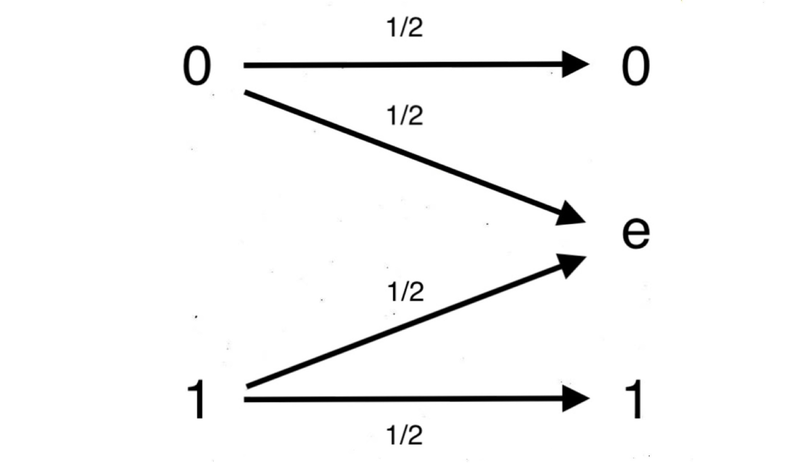
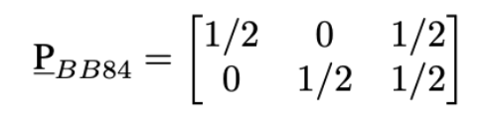
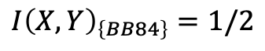
BB84 channel model (without eavesdropping)
One of the most important applications of quantum information theory and cryptography is Quantum Key Distribution: a secret key is exchanged through a quantum communication
channel using quantum states, and then it can be used as a one-time pad key in a cryptosystem. We can use the tools of information theory to construct a channel model of the BB84 protocol:
Probability matrix:
Capacity:
$$I{\left(X,Y\right)}_{\left\{BB84\right\}}=1/2$$

Slide 4
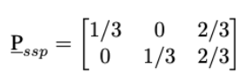
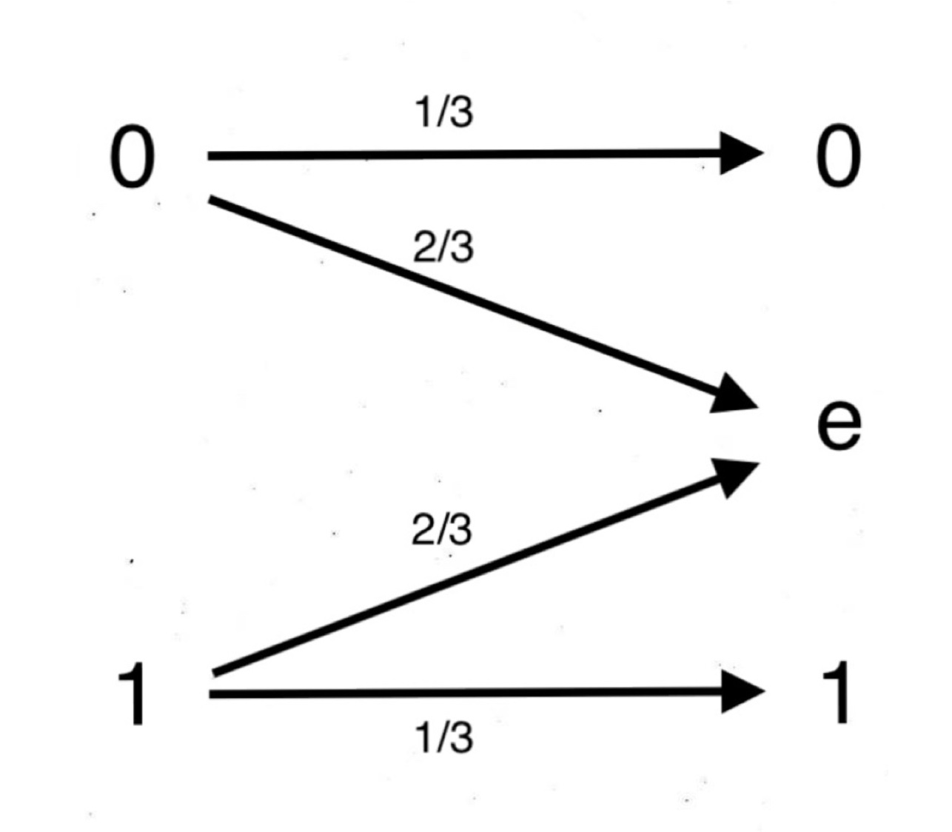
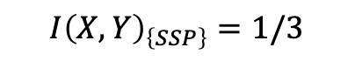
SSP channel model (without eavesdropping)
The channel for the six-state protocol is similar:
$$I{\left(X,Y\right)}_{\left\{SSP\right\}}=1/3$$
We receive, on average, a bit for the secret key every 3 channel uses, which is worse than the BB84 protocol. However, as we will see in the following examples, the SSP trades it off for a better resilience against eavesdropping.

Slide 5
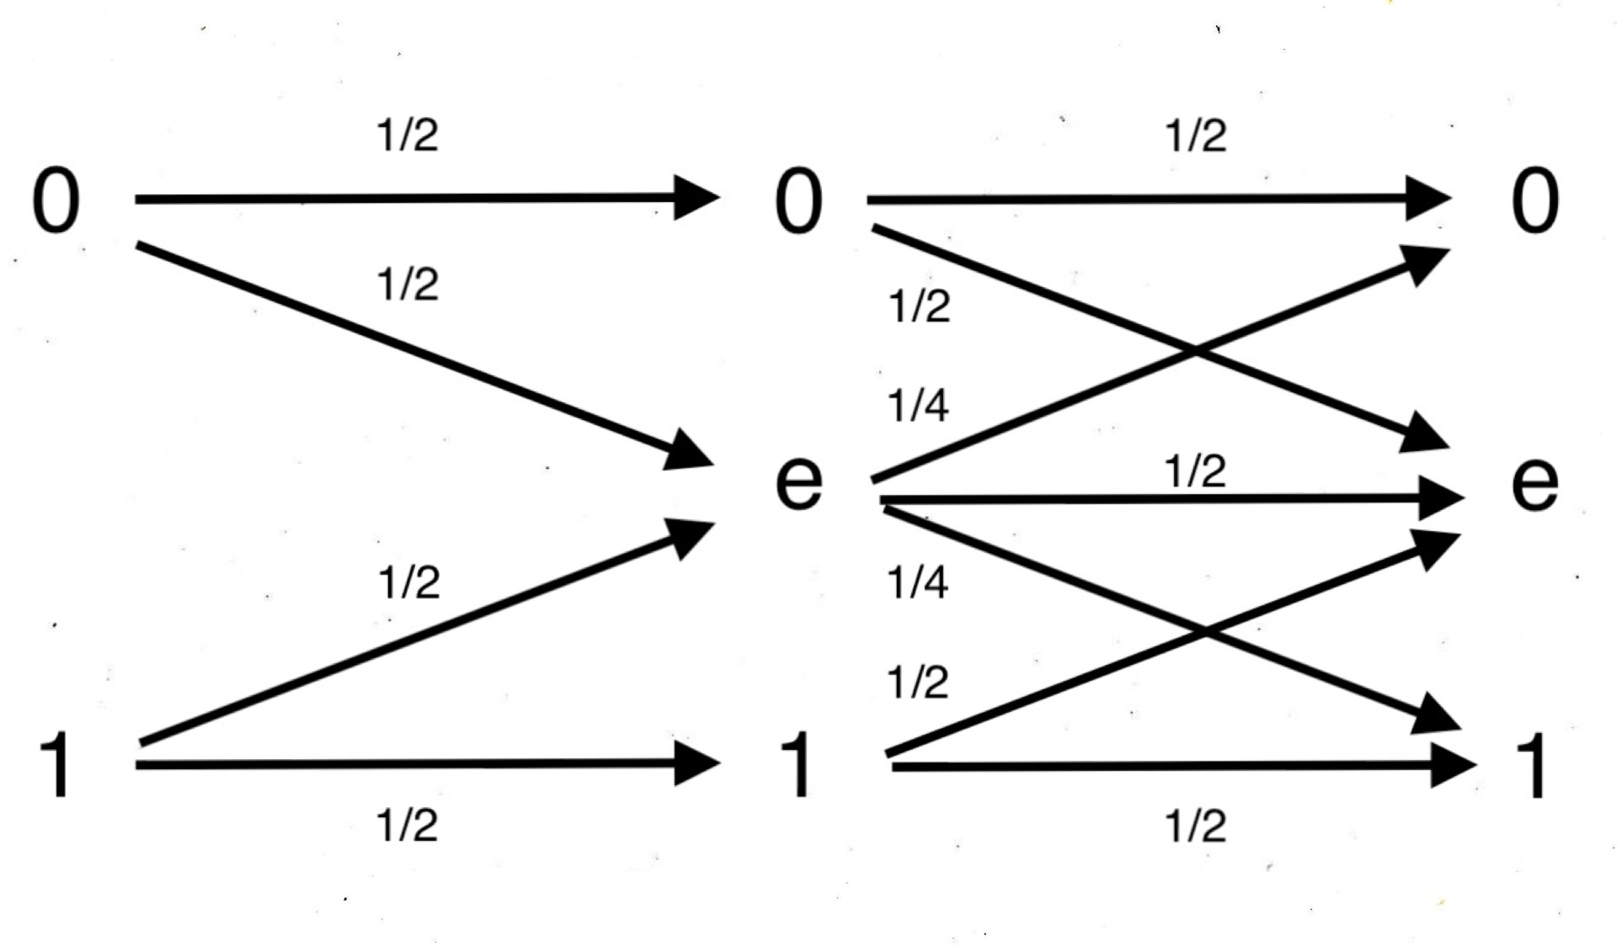
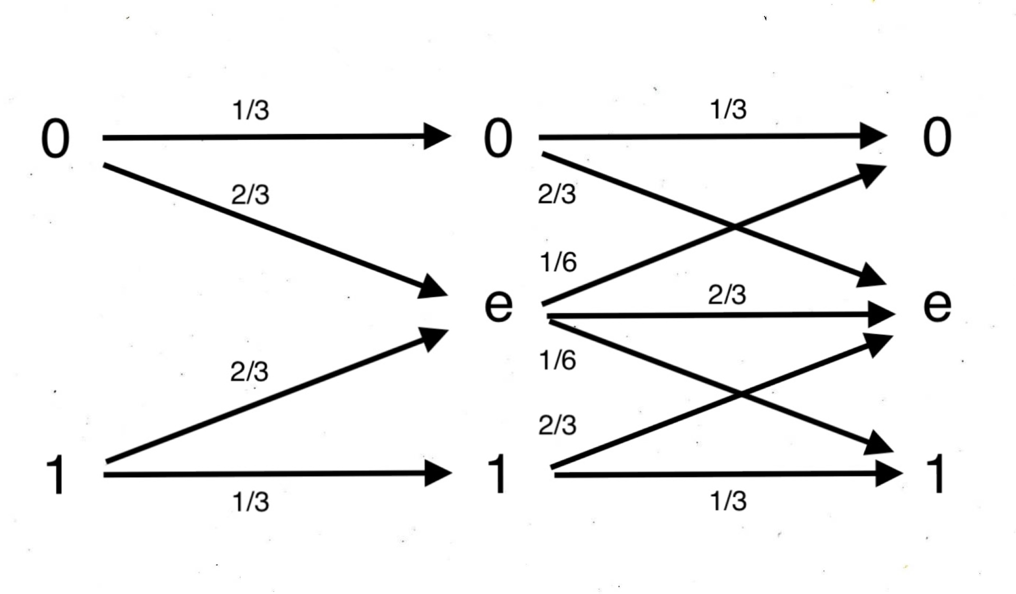
BB84 and SSP channel models (intercept-resend attack)
Ideally, the sifted keys obtained by Alice and Bob should be the same, but in a real scenario we also have to consider the presence of an eavesdropper (Eve) and its effect on the channel capacity. In case of the intercept-resend attack we have the following channel models:
BB84
SSP

Slide 6
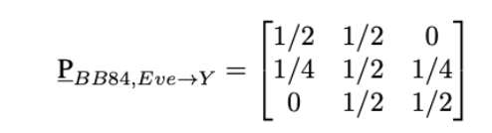
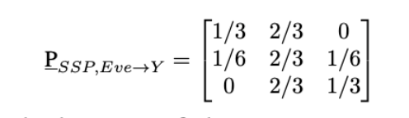
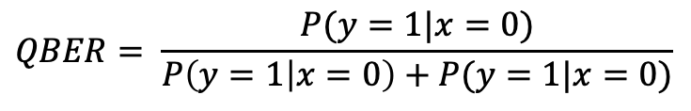
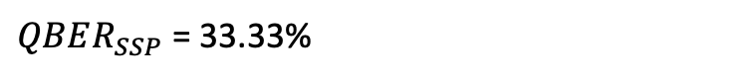
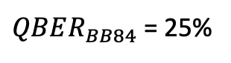
BB84 and SSP QBER
We can calculate a quantity called Quantum Bit Error Rate (QBER), which is defined as the number of the wrong (flipped) bits of the sifted key over the length of the sifted key:
$$QBER= \frac{P(y=1|x=0)}{P\left(y=1 | x=0\right)+P(y=1|x=0)}$$
$QBER_{BB84}$ = 25%
$QBER_{SSP}$ = 33.33%

Slide 7
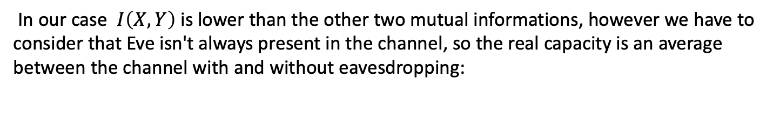
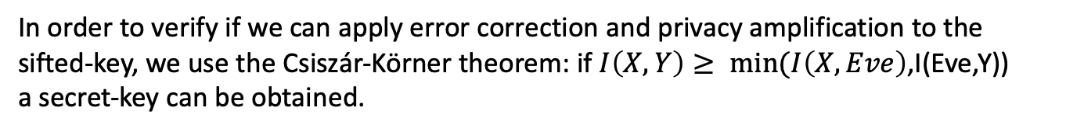
Maximum QBER for error correction and privacy amplification
In order to verify if we can apply error correction and privacy amplification to the sifted-key, we use the Csiszár-Körner theorem: if $I\left(X,Y\right)≥ min(I\left(X,Eve\right)$,I(Eve,Y))
a secret-key can be obtained.
In our case $I\left(X,Y\right)$ is lower than the other two mutual informations, however we have to consider that Eve isn't always present in the channel, so the real capacity is an average between the channel with and without eavesdropping:
$$I{\left(X,Y\right)}_{EVE}⋅μ+ I{\left(X,Y\right)}_{NO EVE}⋅\left(1−μ\right)≥I\left(EVE,Y\right)$$
Where $μ$is a coefficient that rapresents of how much Eve can interfere before ruining the key.

Slide 8
Maximum QBER for error correction and privacy amplification
For the BB84 case:
$$μ_{BB84}≤0.6161 →QBER_{MAX,BB84}=25\%⋅μ_{BB84}=15.4\%$$
Which is analogous to the result obtained by Gisin et al.
For the SSP case:
$$μ_{SSP}≤0.7259 →QBER_{MAX,BB84}=33\%⋅μ_{BB84}=24.2\%$$
This is a higher value than the maximum QBER of BB84 (15.4%), so we have quantitatively demonstrated that the six-state protocol is more resilient against intercept-resend attacks.
How can we improve the channel capacity and the QBER? We want to investigate the CV-QKD

Slide 9
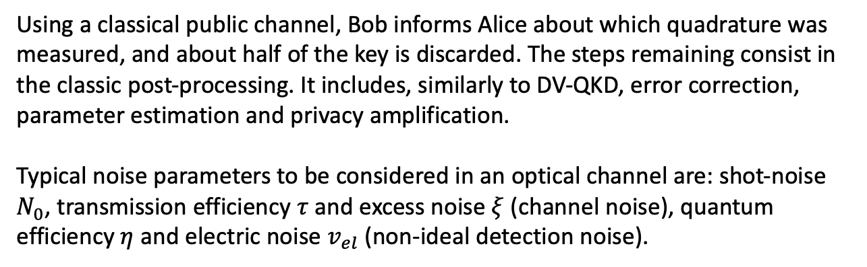
Continuous-Variable QKD
The simplest CV-QKD protocol that exploits coherent states is the GG02, and it resembles in some features the BB84 protocol: Alice prepares a finite number of coherent states, picking them from a complex Gaussian probability distribution with zero mean and variance V. The states are sent to Bob, which measures at random one of the quadrature with homodyne detection.
Using a classical public channel, Bob informs Alice about which quadrature was measured, and about half of the key is discarded. The steps remaining consist in the classic post-processing. It includes, similarly to DV-QKD, error correction, parameter estimation and privacy amplification.
Typical noise parameters to be considered in an optical channel are: shot-noise $N_{0}$, transmission efficiency $τ$ and excess noise $ξ$ (channel noise), quantum efficiency $η$ and electric noise $v_{el}$ (non-ideal detection noise).

Slide 10
To simplify the analysis of the protocol in terms of key extraction, information rate and QBER, it's convenient to use a discrete modulation of coherent states, whose constallation is shaped on a Gaussian distribution (following the work of Roumestan et al.)
Shot noise, phase noise and dispersion…

